Slide 1
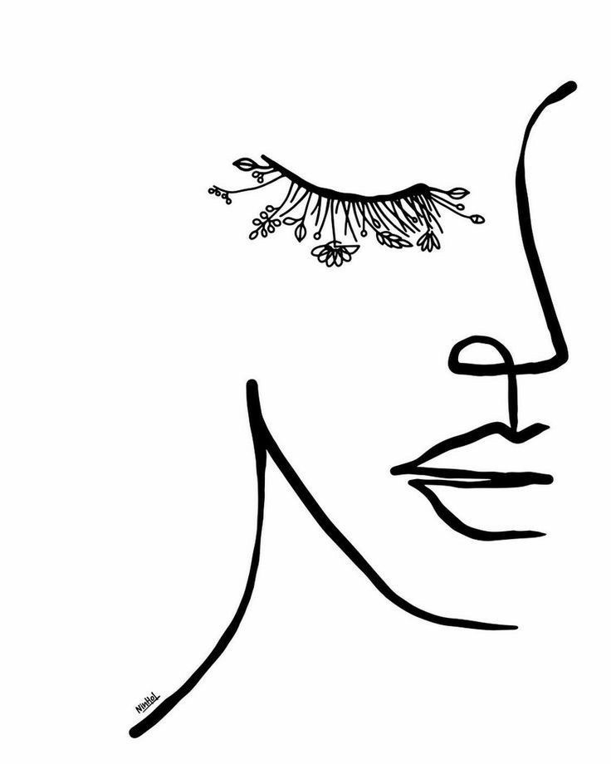

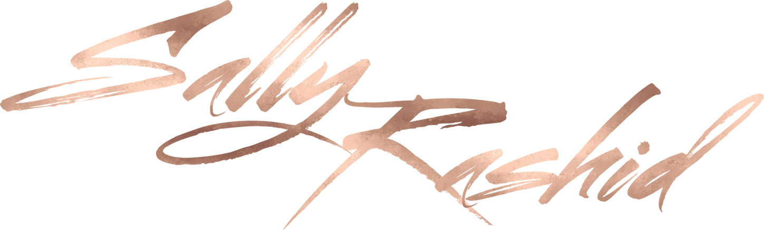
Talent Master Class
Talent Master Class
By
By

Slide 2
Outline:
Artist’s persona
kit must haves -brushes-client-consultation- make up steps)
Mastering the Face(skin prep-choosing foundation-skin tones & correction
-diff face shapes-controuring)
Mastering EYES and BROWS (eye mapping – application for different eye shapes
–gradient eye- brow shaping)
light enhancing make up application
Dramatic sophisticated make up
Mindset/social media tips
Talent Master Class
By

Slide 3
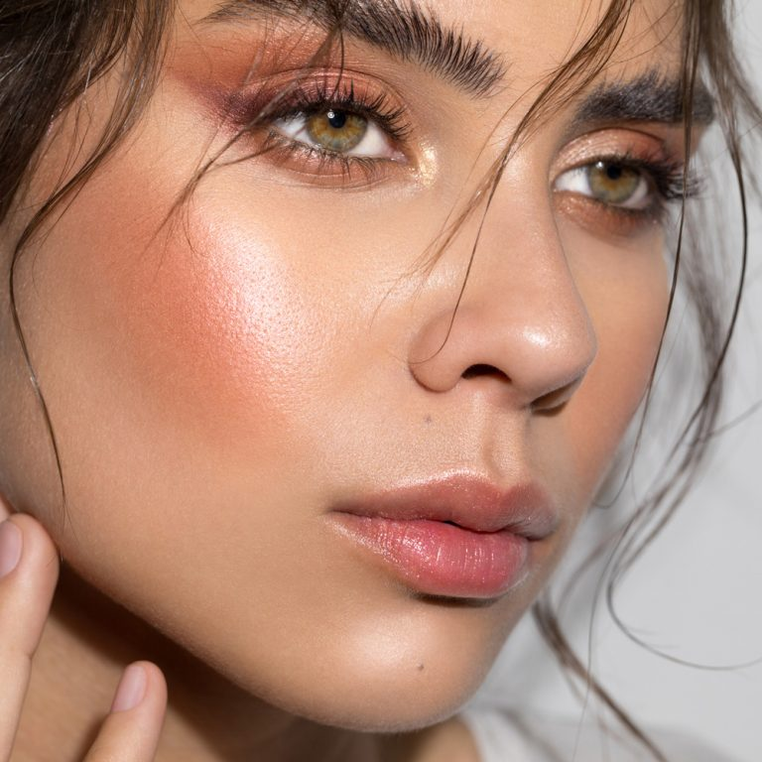
Objective
To learn the Mind set, skills and tools you need to kick off a Makeup artistry JOB

Slide 4
Impression counts
Hygiene
Attitude
Listening
Patience
Serenity (energy)
Respect
intention
There are so many Artists out there
but there is only one
YOU

Slide 5
Kit Must Haves
Moisturizer
Eye, face and lip primer
Foundation (yellow and pink shades)
Translucent powder
Compact /mineralize powder
Contouring set (cream and powder)
Concealers
Correctors (yellow & orange)
Brown and black eyeliners and kohl
Matte brown eye shadows ( medium & dark)
Eye shadow palettes
Mascara
Lipsticks and lip liners ß
Brushes
Beauty blender
Lashes
Make up remover
Toner
Cotton + Q.tips
Tweezers
Scissors
Fixing spray
Mints, hand sanitizor
and Deoderant

Slide 6
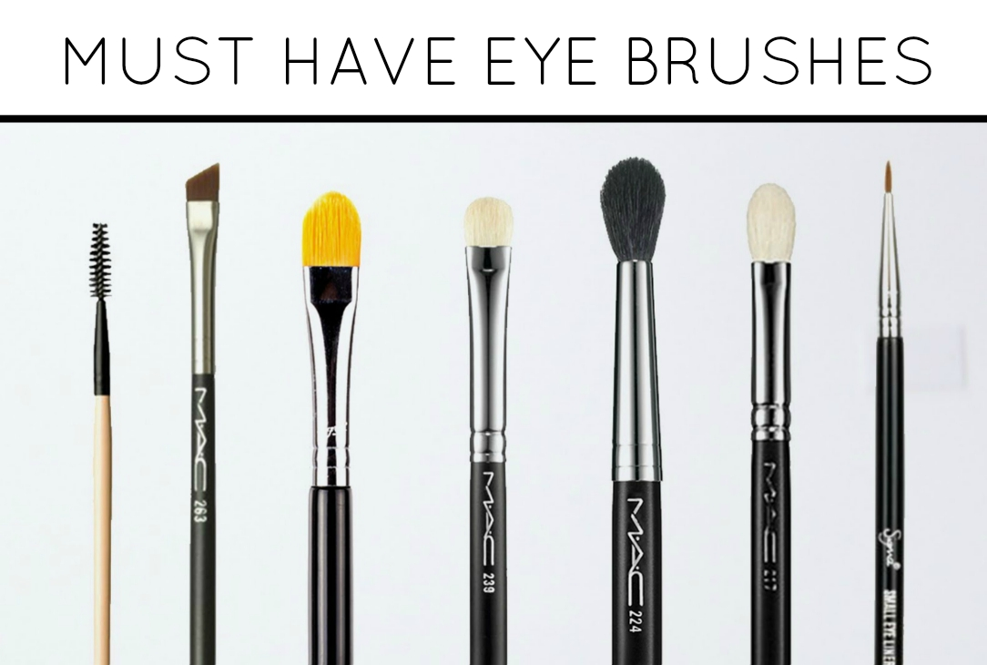

Slide 7
Examples of brushes
217 Blending brush – If you can only have one blending brush, make it this one! Used for crease blending.
224 Blending Tapered brush – Bigger, less dense and more fluffy than 217. This brush picks up less pigments, and it is great for applying a sheer wash of color. Used for applying under eye powder.
219 Pencil brush: Pencil brush is for drawing lines then smudging it for a softer blended finish. The pencil shaped tip allows precise application around the eye corners and along lash lines. Absolutely must have if you like to smudge a soft wash of color along the lower lash line.
228 mini shader brush
239 Eye Shader brush: Having a couple of shader brushes , designed for laying down the shadows on the lid and prevents fall out to build a more intense finish.
168 Large Angled Contour brush, it’s a versatile brush as it can be used for applying blushes, as well as for buffing highlighting/shading colors for contouring purposes with the slanted angle design.
129 Powder and Blush brush: A good and basic design for a dome shaped blush brush. It has the right size and shape for multiple ways of application for the cheeks, The full rounded shape gives an even and smooth finish.
195 concealer brush

Slide 8
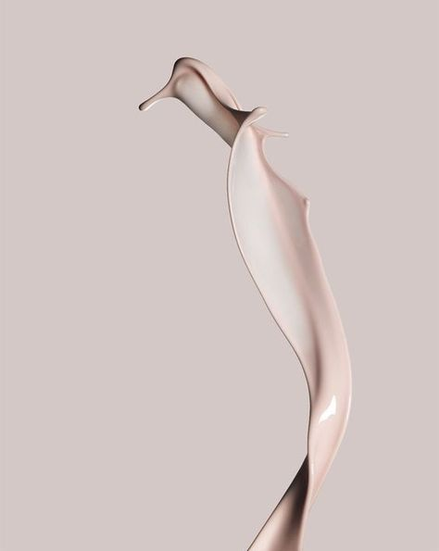
Make Up Steps
Clean/Exfoliate
Hydrate
Primer
Foundation
Concealer
Powder
Contour
Blush
Highlighter
Lashes
Lipliner
Listick
Fixing spray
Notes:
kkjj

Slide 9
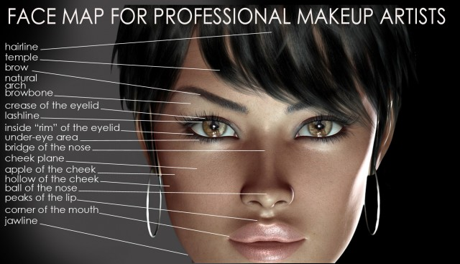

Slide 10
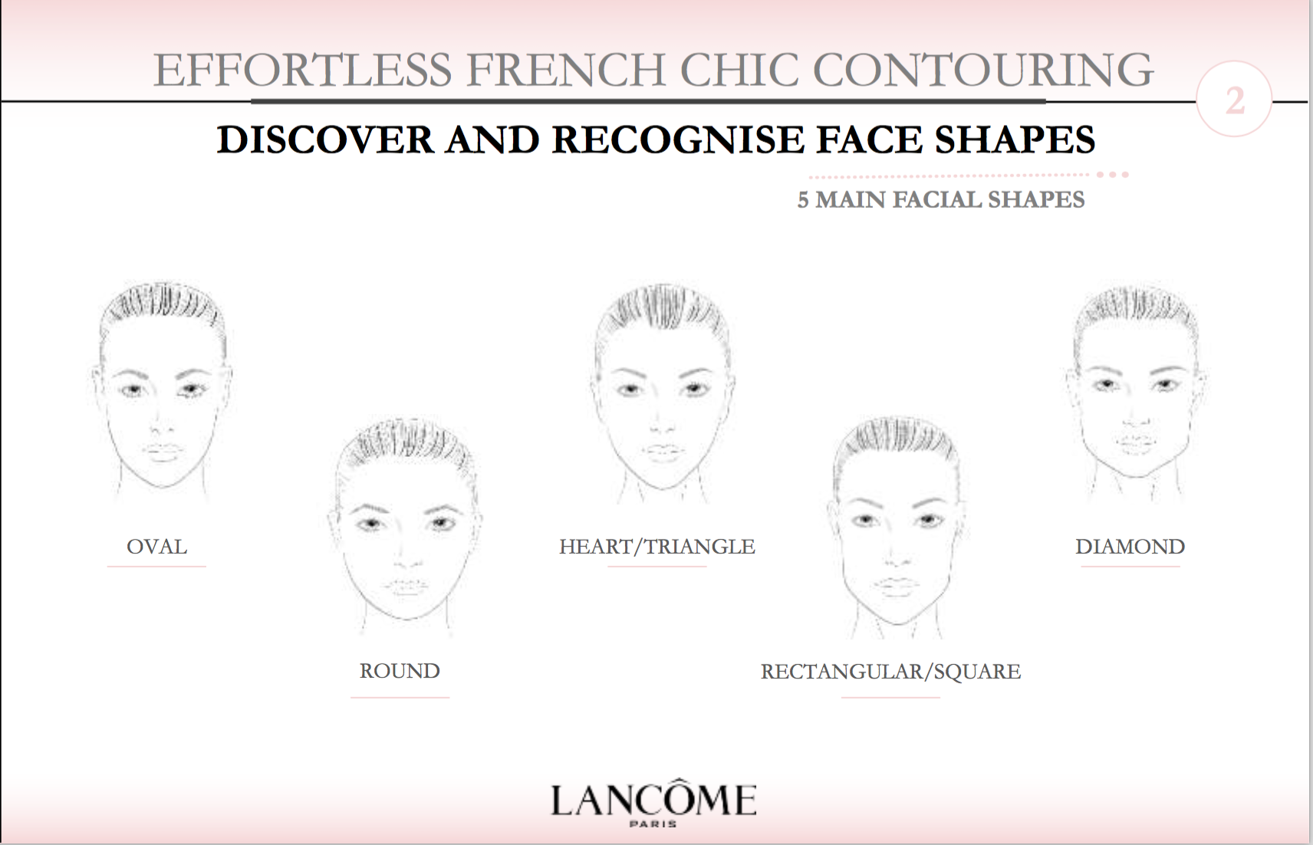

Slide 12
Eyes Shapes
The Almond shape is considered the neautral shape where almost all make up styles suits it and looks flattering on it.
Wide set and close set: do not extend the dark colour away from the ending of the lash line much.
Deep set : Use highlights, shimmers & light colours, avoid dark colours
Prominent set: Use medium to dark, avoid light reflective colours in the center.
Droopy Eyes: make sure to create a lift with dark shadows and eyeliners , pointing them towards the end of the brow.
Hooded eyes: Make sure to raise the shadows higher than the actual crease. And ask them to open their eyes often during application

Slide 13
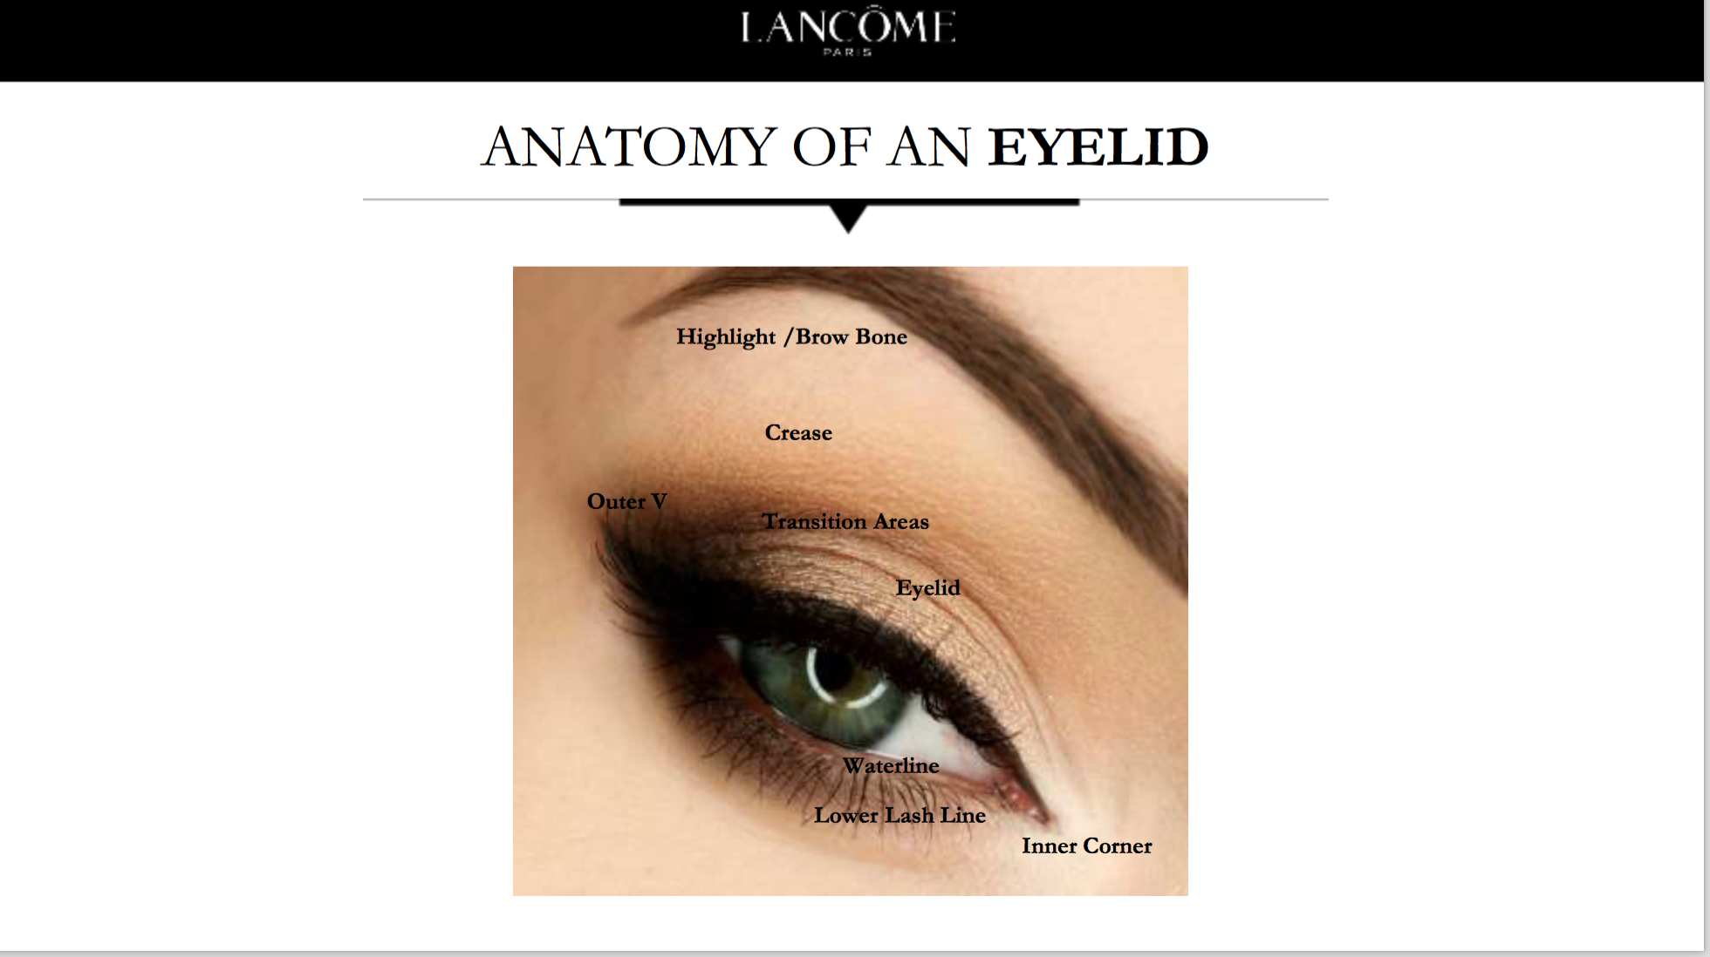

Slide 14
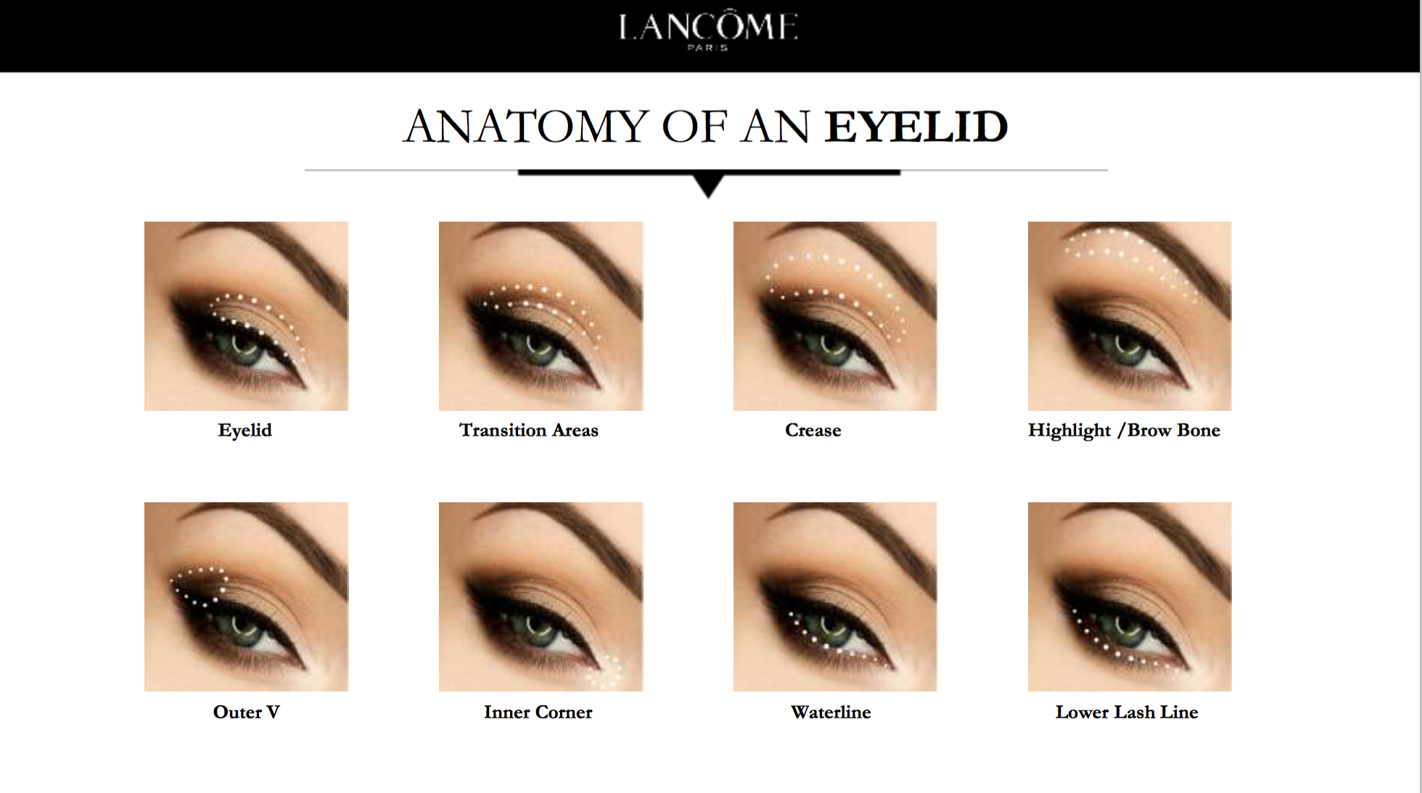

Slide 15
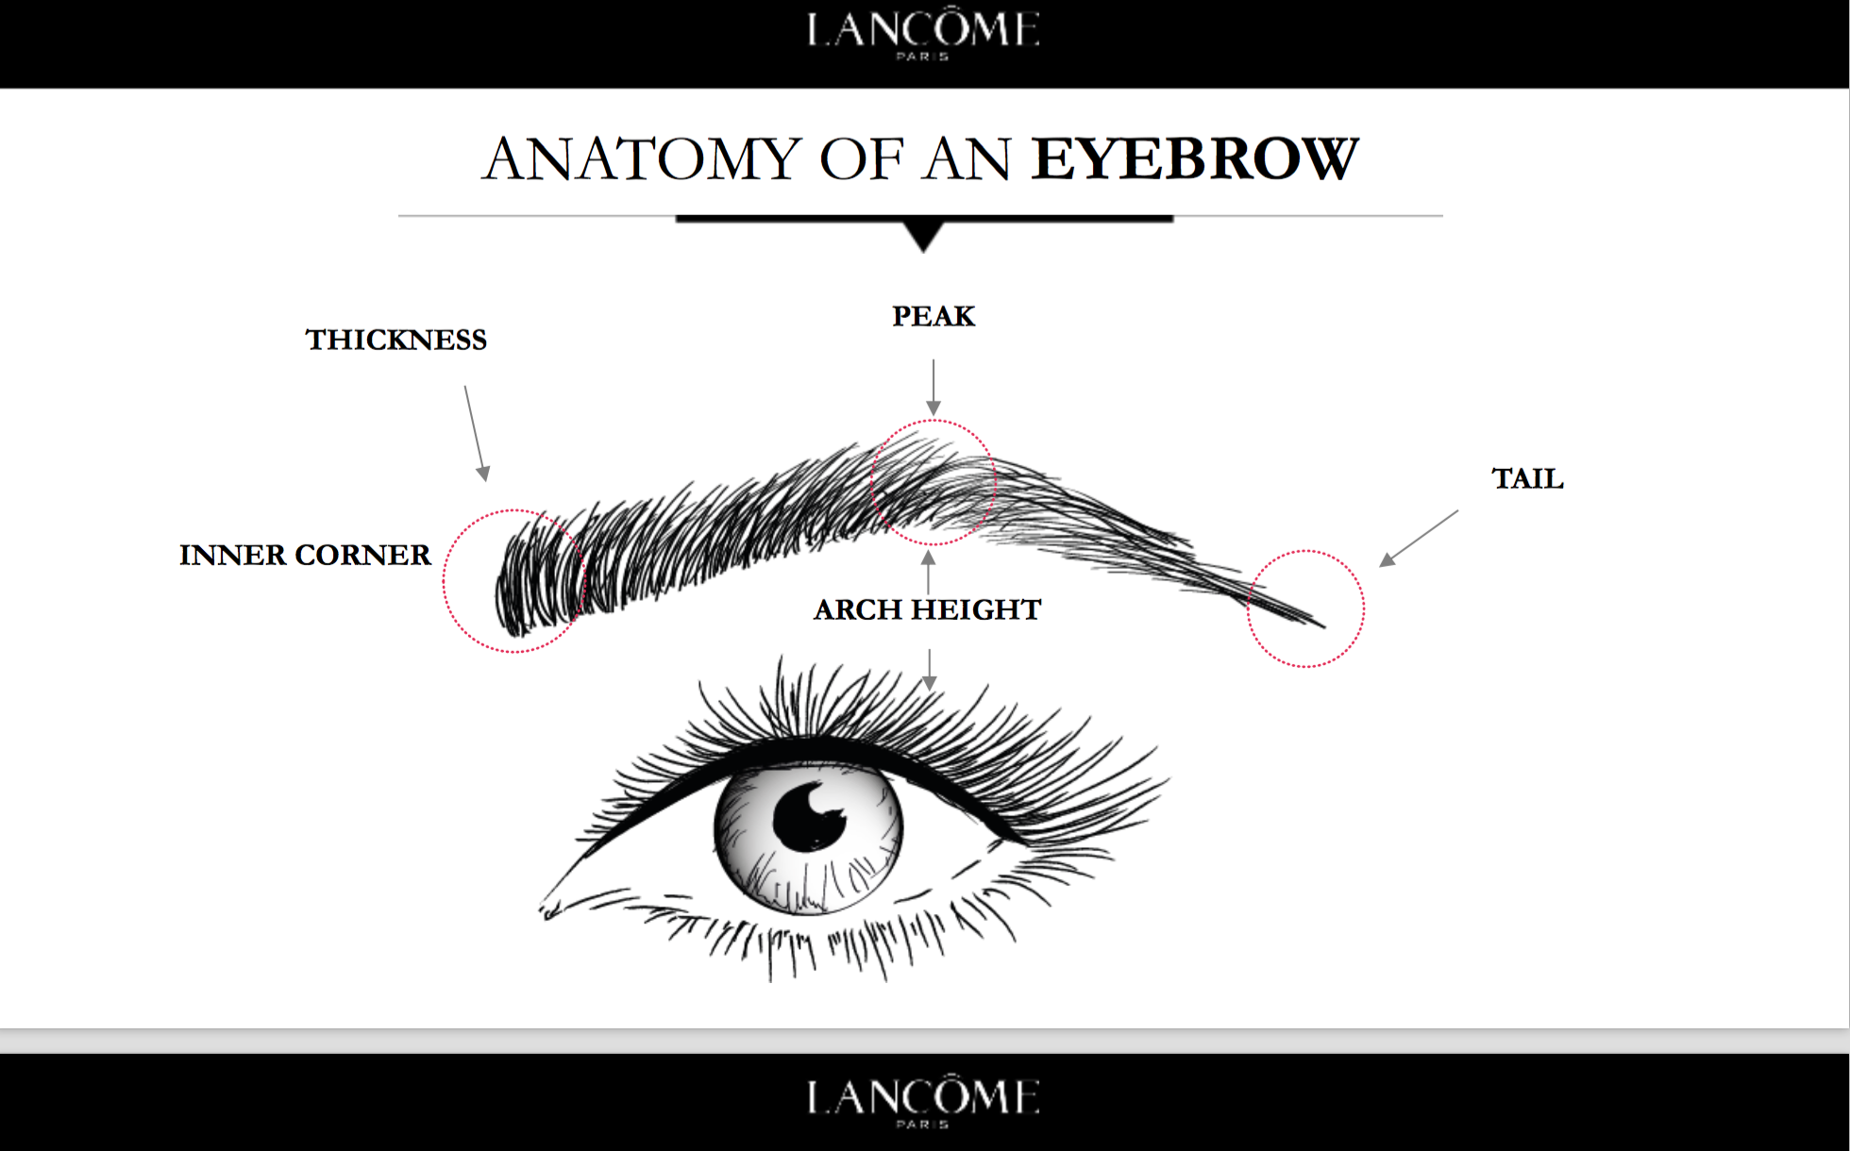

Slide 16
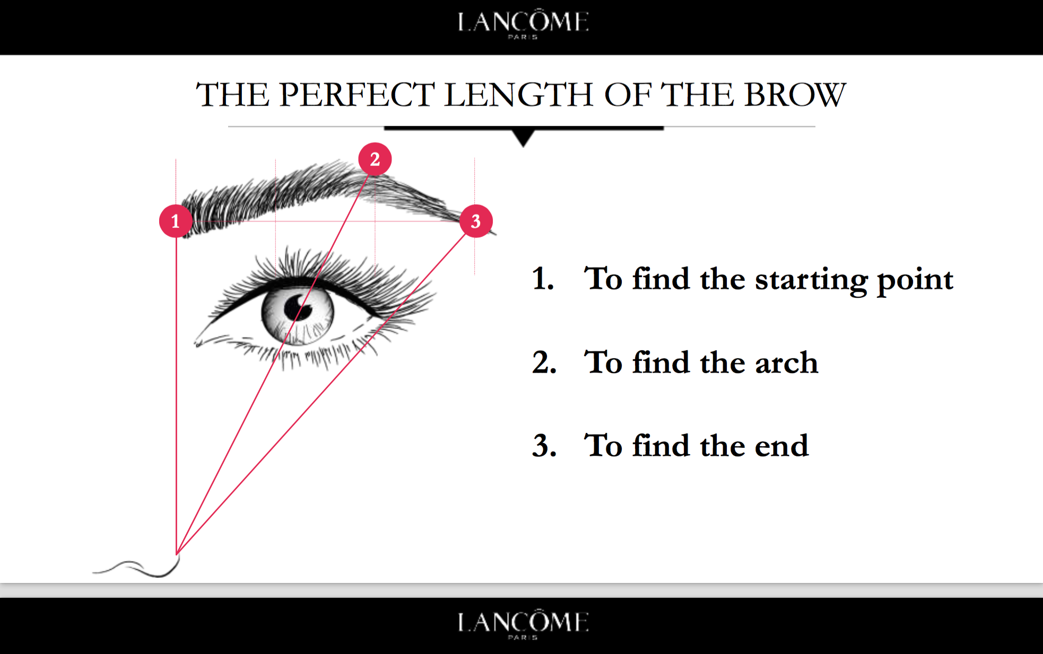

Slide 17
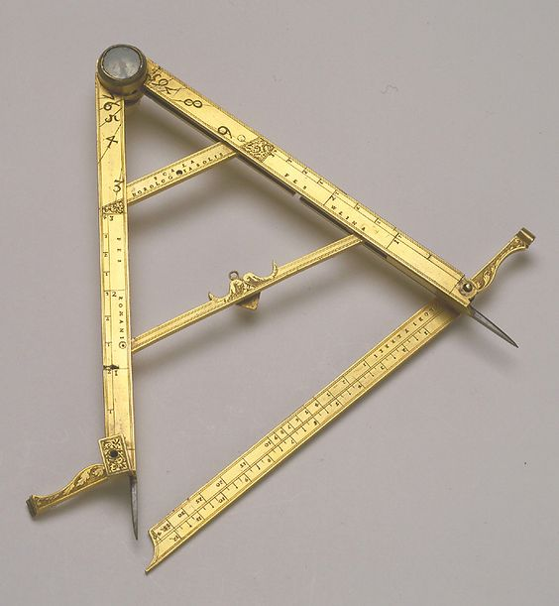
Goals
Specific
Measurable
Attainable
Realistic
Timed
Notes:
Setting SMART goals:
Ask yourselves: What would your GM want to know?
# booked & show-rate
Total time of MC and % of the day’s business contribution
Conversion rate for event and by axis, IPT, AUS
New Vs Loyal clients
Additional items discussed – how to motivate others to book; how to handle commissions, etc. The group agreed these topics were crucial to the success of the program and will continue the discussion with their Field Management.

Slide 18
MIND SET
In order to grow your business you have to grow your mind!
Don’t reinvent the wheel, check some profiles of artists online who inspire you (bios, documentaries, online videos , Audio books and podcasts)
Invest in your self and your business.
Keep moving keep trying new things, it will always be a learning experience.
Guide your self talk
Stay in your business /don’t compare
Plan your next step!
THE TRAPS
Comparison
Mistake
Right time
perfection

Slide 19
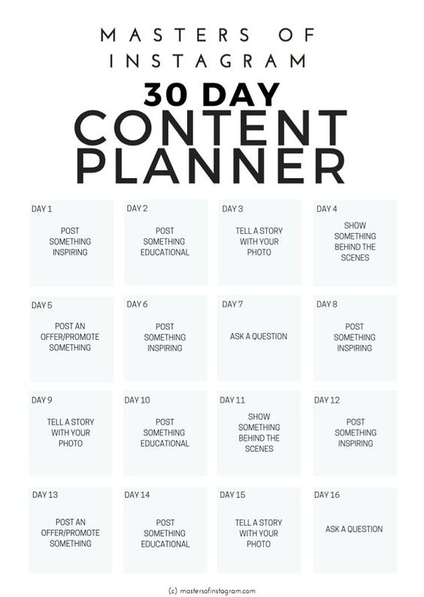
Social media tips
Check your insights to know what works most
Know your Audience
Think added value
Create timely presence
Share a bit of You
Use apps like UNUM, Content office, VSCO, Facetune, Unfold
Plan your content

Slide 20
YOU Are
An
Artist!
What are your most important Values?
What are you telling yourself I can’t?
Turn it into I can and put tiny
action steps
You are becoming what you believe you are, make a good set of belief about your self!

